Slide 1
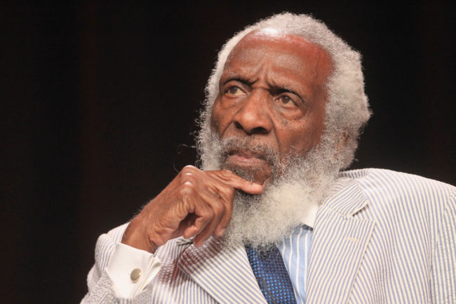
Shame
Dick Gregory

Slide 2
Detailed Understanding of the Text
1. I was in love with a little girl named Helene Tucker, a light-complexioned little girl with pigtails and nice manners. (Para. 1)
►Please explain the reddened words in English.
►Please translate the sentence into Chinese.

Slide 3
Detailed Understanding of the Text
2. I’d get a pot, and go over to Mister Ben’s grocery store, and stick my pot down into his soda machine. Scoop out some chopped ice. (Para. 1)
►Please explain the reddened words in English.
►Please combine the two sentences into one.

Slide 4
Detailed Understanding of the Text
3. Everybody’s got a Helene Tucker, a symbol of everything you want. (Para. 2)
►Please paraphrase this sentence in English.

Slide 5
Detailed Understanding of the Text
4. ...and I’d rub my tennis sneakers on the back of my pants and wish my hair wasn’t so nappy and the white folks’ shirt fit me better. (Para. 2)
►Please explain the reddened words in English.
►What can you infer from the author’s reaction on seeing Helene?

Slide 6
Detailed Understanding of the Text
5. I guess I would have gotten over Helene by summertime, but something 3 happened in that classroom that made her face hang in front of me for the next twenty-two years. (Para. 3)
►Please paraphrase this sentence in English.

Slide 7
Detailed Understanding of the Text
6. It wasn’t until I was twenty-nine years old and married and making money that I finally got her out of my system. (Para. 3)
►Please explain to us the usage of “not...until”.

Slide 8
Detailed Understanding of the Text
7. Maybe you could sneak into the cloakroom and steal a bite of some kid’s lunch out of a coat pocket. (Para. 5)
►Please explain the reddened words in English.

Slide 9
Detailed Understanding of the Text
8. I had money in my pocket from shining shoes and selling papers, and whatever Helene Tucker pledged for her Daddy I was going to top it. And I’d hand the money right in. I wasn’t going to wait until Monday to buy me a Daddy. (Para. 7)
►Please explain the reddened words in English.
►Please translate the sentences into Chinese.

Slide 10
Detailed Understanding of the Text
9. “We are collecting this money for you and your kind, Richard Gregory. If your Daddy can give fifteen dollars you have no business being on relief.” (Para. 20)
►Please paraphrase the two sentences in English.
►Please translate the sentences into Chinese.

Slide 11
Detailed Understanding of the Text
10. I’d been out hustling all day, shining shoes, selling newspapers, and I had googobs of money in my pocket. (Para. 29)
►Please explain the reddened words in English.

Slide 12
Detailed Understanding of the Text
11. He just said: “Don’t have no money.” (Para. 31)
►Did the wino have any money or not?
►If you were in the restaurant, would you have helped the wino out? Why or
why not?

